Slide 1
E6156 – Topics in SW Engineering: Cloud Computing
Lecture 4: APIs, REST, SSO, Events
© Donald F. Ferguson, 2021

Slide 2

Contents
2 | E6156 – Topics in SW Engineering: Lecture 4: APIs, REST, SSO, Events © Donald F. Ferguson, 2021

Slide 3
Agenda
Status and discussion.
A motivating scenario: user registration “side effects.”
Technical topics:
Cloud identity providers, SSO, social networks, OAuth2, ... ...
APIs and the API economy – use and consume APIs.
Event driven processing.
Good REST APIs: Part II
Next steps and next sprint.

Slide 4
Clarification
4 | E6156 – Topics in SW Engineering: Lecture 4: APIs, REST, SSO, Events © Donald F. Ferguson, 2021

Slide 5
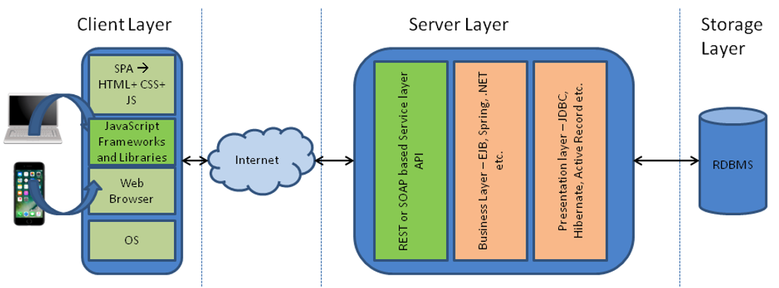
Simple Flask Application – Configuration
Possible configurations:
There are three “things:” web server, application server, DB server.
A “thing” can be on your laptop or on AWS.
You want your code to be the same and get information from the configuration.
One simple approach is environment variables for web application.
The angular application can use the URL because. Why would the cloud deployed angular application access your local web application.
Show code for environment variables and how to set environment variables.
Locally in PyCharm
On EC2 (.bash_profile)
Show use of URL in Typescript.
These approaches are “OK” but there are more secure approaches.
Also, remember to set security group rules properly.

Slide 6
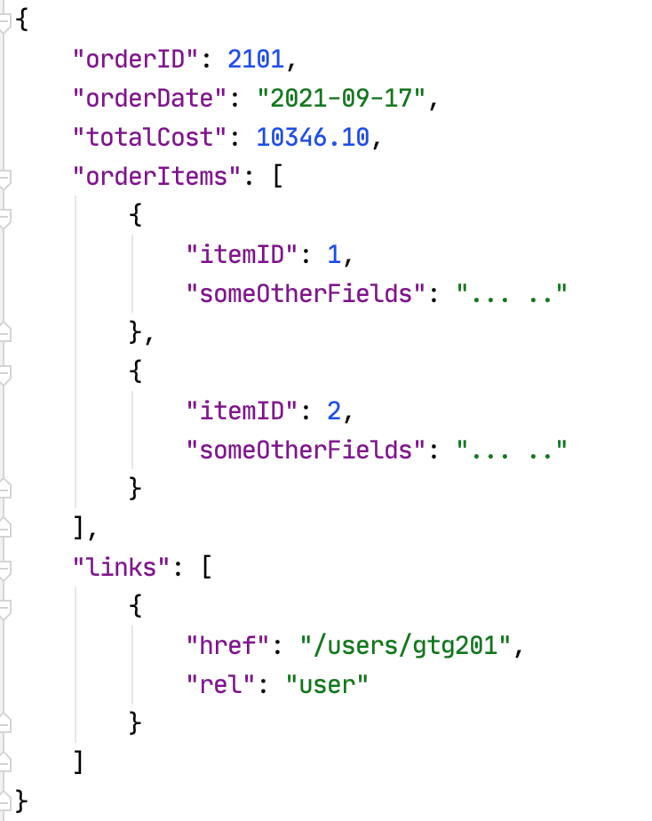
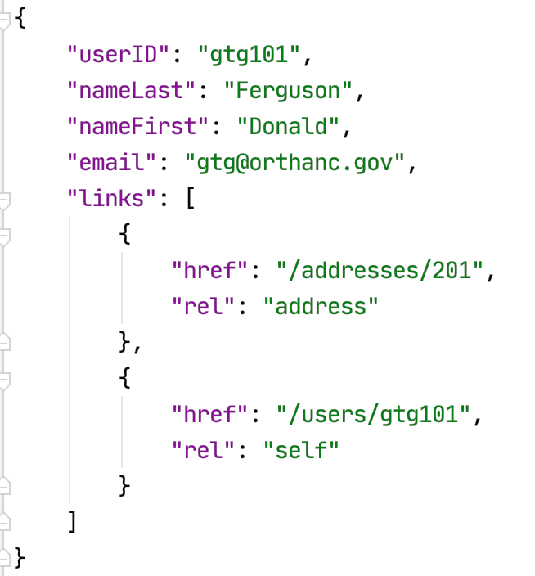
Resource Paths
The simple object model might/could/would/should have the following:
/users
/users/<userID>
/users/<userID>/address
/users/<userID>/orders
/addresses
/addresses/<addressID>/users
/orders/<orderID>
/orders/<orderID>/orderitems
/orders<orderID>/orderitems/<itemID>
... ...
How do you “point backwards” in a “foreign key relationship,” e.g. Address → User
“href” : “/users?addressID=201”
This means you store the addressID in the DB but return a link om REST.
Composition
Association

Slide 7
Users
/users [GET, POST]
POST: Data → Collection of Users → INSERT INTO .... ...
GET: → SELECT * WHERE .... .....
/users
/users?last_name=Ferguson&iq=40 → select * from users where last_name=‘Ferguson’ and iq=40
/users?last_name=Ferguson&iq=40&fields=last_name,first_name,iq,hat_size →
Select last_name, first_name, iq, hat_size from users where last_name=‘Ferguson’ and iq=40
/users?last_name=Ferguson&iq=40&fields=last_name,first_name,iq,hat_size&limit=10&offset=10
Select last_name, first_name, iq, hat_size from users where last_name=‘Ferguson’ and iq=40 limit =10 offset =10

Slide 8
{
“rel”: “next”,
“href”: /users?last_name=Ferguson&iq=40&fields=last_name,first_name,iq,hat_size&limit=10&offset=20 },
{
“rel”: “prev”,
“href”: /users?last_name=Ferguson&iq=40&fields=last_name,first_name,iq,hat_size&limit=10&offset=0 },
{
“rel”: “self”,
“href”: /users?last_name=Ferguson&iq=40&fields=last_name,first_name,iq,hat_size&limit=10&offset=10 }
Next
Prev

Slide 9
Motivating Scenario
9 | E6156 – Topics in SW Engineering: Lecture 4: APIs, REST, SSO, Events © Donald F. Ferguson, 2021

Slide 10
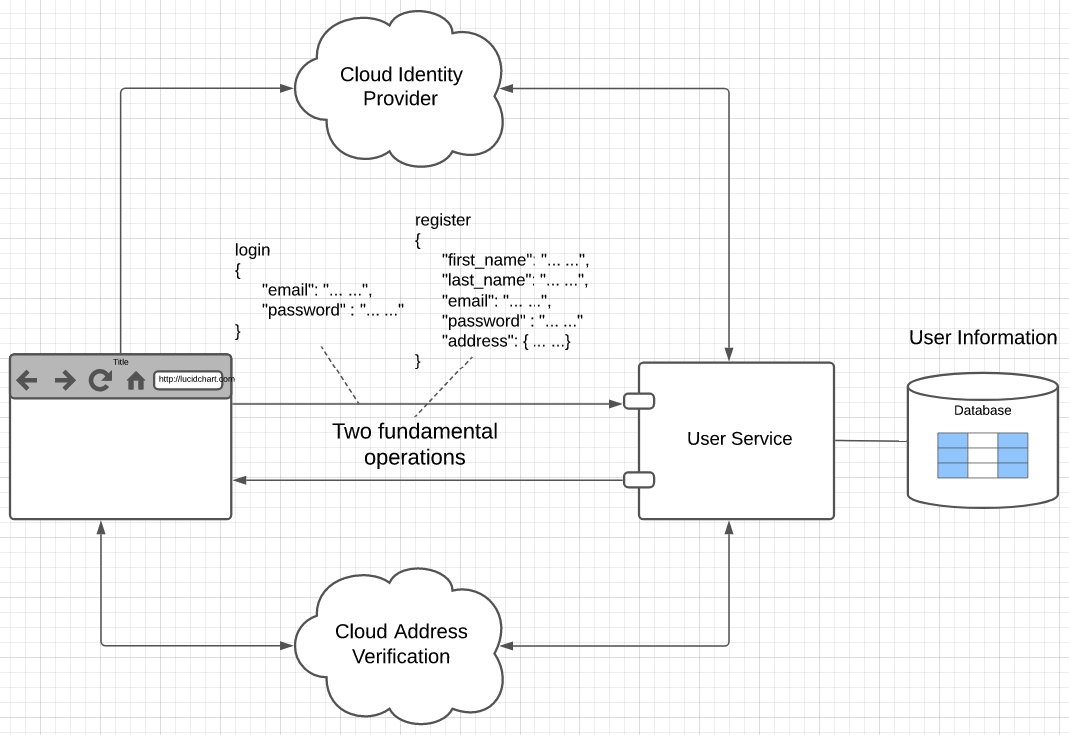
User Registration, Login and Profile
Two major challenges:
User management:
Securing the user/password database.
Implementing password reset.
Verifying email ownership to avoid spamming by registration.
Two factor
... ...
Addresses:
People are very bad at entering address information.
“620 w 120th St, NY NY”
”620 West 120th Street, NYC, NY”
Implementing these functions is tedious and non-core to your business. ➔ Use cloud services.

Slide 11
Modifying My Sample (Core) Project
I am changing the nucleus of the sample project I use for this class.
My application is normally simulated Fantasy Baseball. The core microservices are:
User, User Profile.
Lahman’s Baseball DB historical player information.
Teams, leagues, ... ... (simulates a catalog).
I have had as much fun as I can trying to manage E6156 students, projects, teams, meeting, ... ...
So, I am building an application that allows students to form and manage teams.

Slide 12
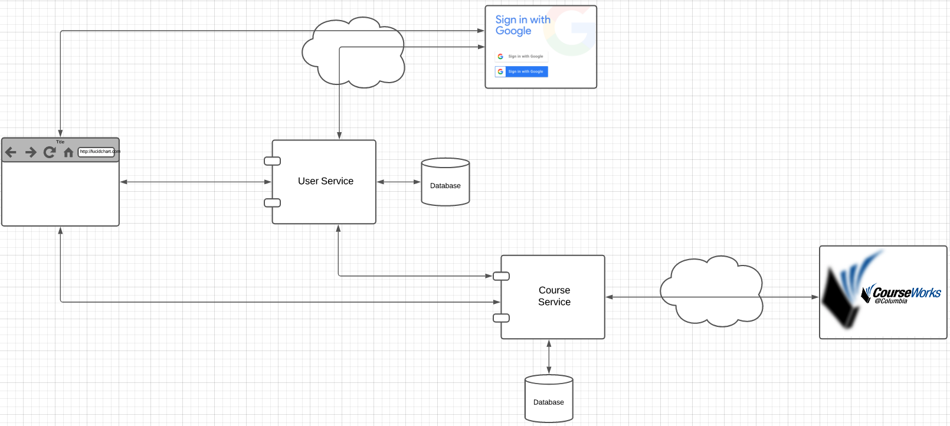
User Service

Slide 13
Cloud Identity (Open ID, OAuth2, ... ...)
13 | E6156 – Topics in SW Engineering: Lecture 4: APIs, REST, SSO, Events © Donald F. Ferguson, 2021

Slide 14
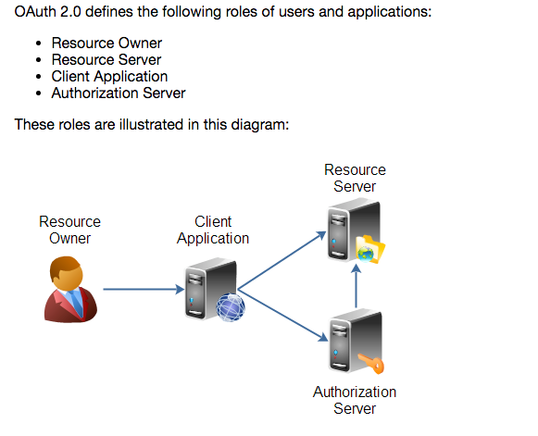
Overview (http://tutorials.jenkov.com/oauth2/index.html)
Resource Owner
Controls access to the “data.”
Facebook user, LinkedIn user, …
Resource Server
The website that holds/manages info.
Facebook, LinkedIn, ...
And provides access API.
Client Application
“The product you implemented.”
Wants to read/update
“On your behalf”
The data the data that the Resource Server maintains, e.g. posts, status, tweets, ...
Authorization Server
Grants/rejects authorization
Based on Resource Owner decisions.
Usually (logically) the same as Resource Server.

Slide 15
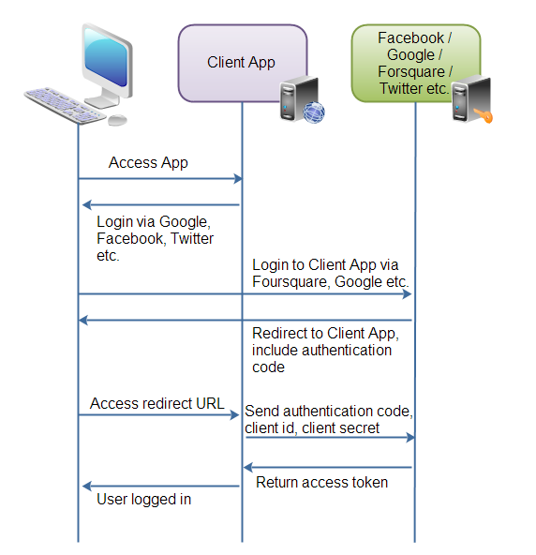
Roles/Flows
User Clicks “Logon with XXX”
Redirect user to XXX
With Client App application ID.
And permissions app requests.
Code MAY have to call Resource Server to get a token to include in redirect URL.
Browser redirected to XXX
Logon on to XXX prompt.
Followed by “do you grant permission to …”
Clicking button drives a redirect back to Client App. URL contains a temporary token.
User/Browser
Redirected to Client App URL with token.
Client App calls XXX API
Obtains access token.
Returns to User.
Client App can use access token on API calls.

Slide 16
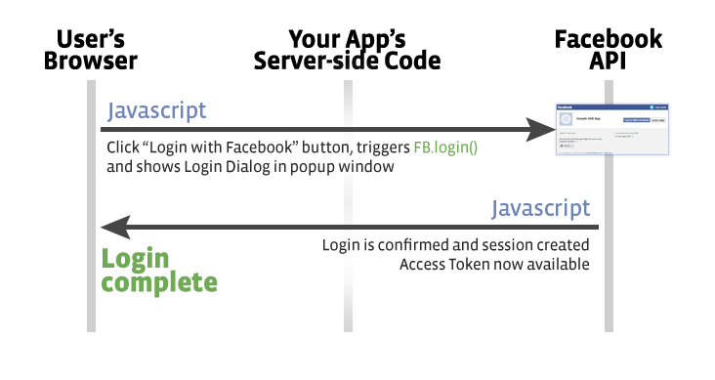
Facebook
Validate Token/Get Info
Register(Token)
OK
Save Data

Slide 17
Some REST Concepts
17 | E6156 – Cloud Computing: Backend-as-a-Service

Slide 18
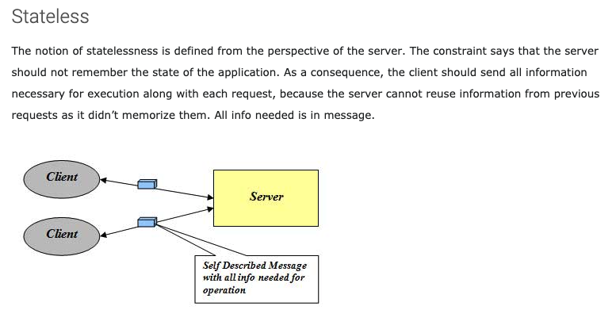
Stateless
http://mrbool.com/rest-architectural-elements-and-constraints/29339
JWT Token A
JWT Token B
JWT Token C

Slide 19
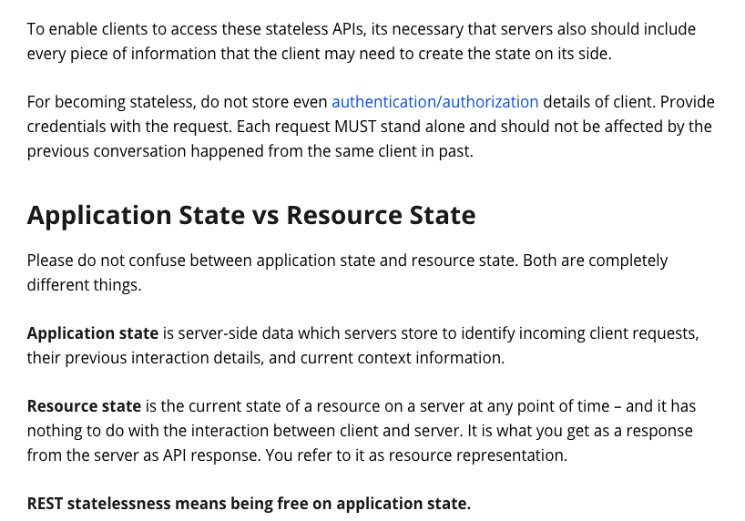
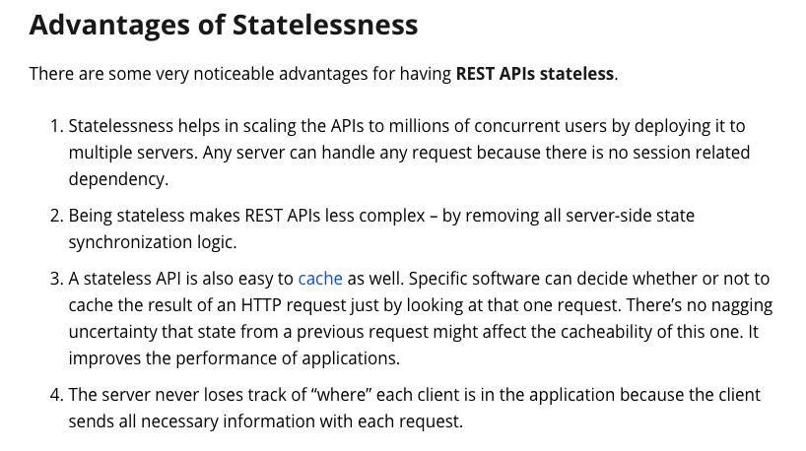
Stateless

Slide 20
REST and Isolation: Read then Update Conflict
Some
Resource
1. Bob GETs the resource.
3. Bob changes the data based on values.
2. Mary GETs the resource.
If
The written value
Depends on the read value.
The resource may be in the wrong state at the end.
The execution was RRWW
But the intent was RWRW.
4. Mary changes the data based on values.

Slide 21
Isolation/Concurrency Control
This requires conversation state, which would violate the REST Stateless principle.
There are two basic approaches to implementing isolation
Locking/Pessimistic, e.g. cursor isolation
Optimistic: Before committing, each transaction verifies that no other transaction has modified the data it has read.
How does this work in REST?
The server maintains an ETag (Entity Tag) for each resource.
Every time a resource’s state changes, the server computes a new ETag.
The server includes the ETag in the header when returning data to the client.
The server may optionally maintain and return “Last Modified” time for resources.
Semantics on updates
If-Match – value of a previous calls ETag response used with a PUT or DELETE. Server should only act if nobody else has modified the resource since you last fetched it. Otherwise provides a 412.
If-Modified-Since – value of a previous Last-Modified response used with a GET. Server should only provide a response if the resource was modified since the timestamp submitted. Use in conjunction with If-None-Match in case the change occurred within the same second. Otherwise provide a 304.
If-None-Match – value of a previous calls ETag response used with a GET. Server should only provide a response if the ETag doesn’t match, i.e. the resource has been altered. Otherwise provide a 304.
If-Unmodified-Since – value of a previous Last-Modified response used with a PUT or DELETE. Server should only act if nobody else has modified the resource since you last fetched it. Otherwise provides a 412

Slide 22
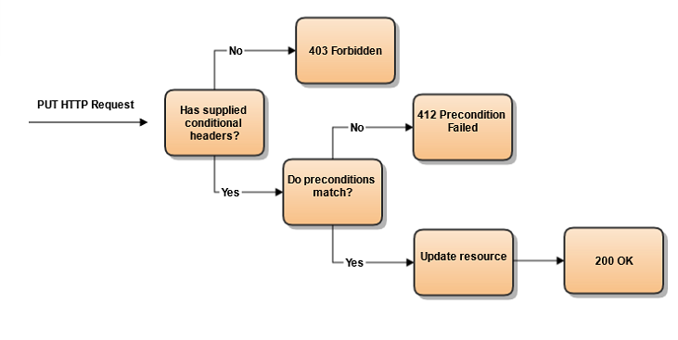
Conditional Processing (https://blog.4psa.com/rest-best-practices-managing-concurrent-updates/)

Slide 23
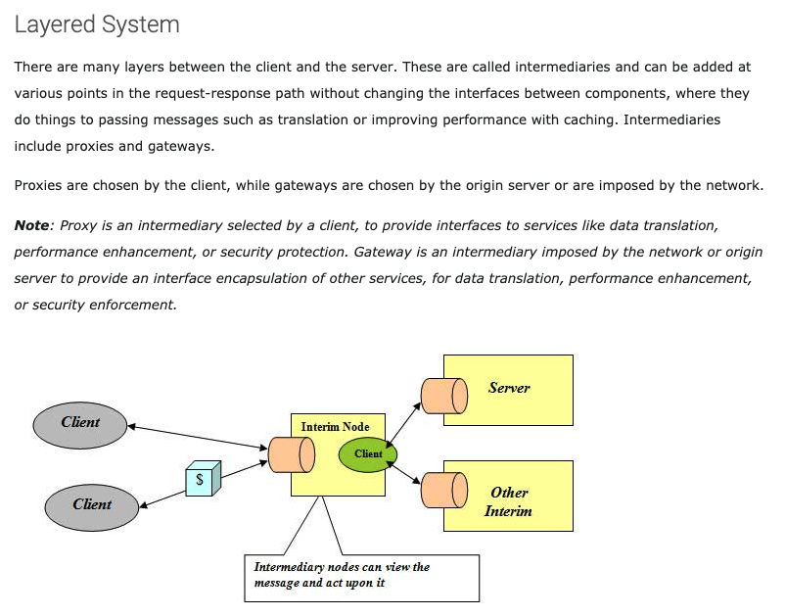
Layered System
Layered System
Proxy/Intermediary provides “middleware”
Separation of Concerns
Examples
Caching
Logging
Security
Queuing
... ...
Middleware
API Gateway
CloudFront
Proxy

Slide 24
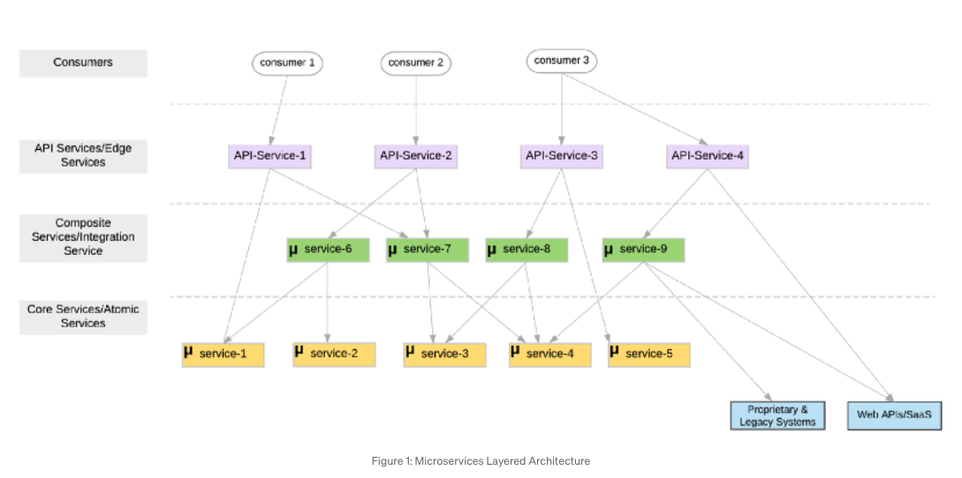
Layered Architecture
https://medium.com/microservices-in-practice/microservices-layered-architecture-88a7fc38d3f1

Slide 25
Layered Architecture
https://medium.com/microservices-in-practice/microservices-layered-architecture-88a7fc38d3f1
1. Core/Atomic Microservices
At the bottom layer, we have fine-grained self-contained services (no external service dependencies) that mostly comprise of the business logic and less or no network communication logic.
2. Composite/Integration Microservices
Atomic microservices are often cannot be directly mapped to a business functionality as they are too fine-grained. Hence a specific business functionality may require a composition of multiple atomic/core services. The middle layer comprises of such composite or integration microservices. ... ...
Composite/integration services are coarse-grained(relative to atomic services), independent from each other and contains business logic(routing, what services to call, how to do data type mapping etc.) ... ...
These services also could bridge the other legacy and proprietary systems(e.g SAP ERP), external web APIs (e.g. Salesforce), shared databases etc. (often known as the anti-corruption layer).
3. API Services/Edge Services
You will expose a selected set of your composite services or even some atomic service as managed APIs using API services/Edge services. These services are a special type of composite services, that apply basic routing capabilities, versioning of APIs, API security patterns, throttling, apply monetization, create API compositions etc.

Slide 26
Composition and Asynchronous Method Invocation
Composite operations can “take a while.”
“Holding open connections and waiting can be bad.”
Consumes resources.
Connections can break.
... ...
There are two options:
Polling
Callbacks
Our next pattern is composition and “polling.” Create a new user requires:
Updating the user database.
Verifying a submitted address.
Creating an account in the catalog service.
Request
202 ACCEPTED Location
GET (Poll)
200

Slide 27
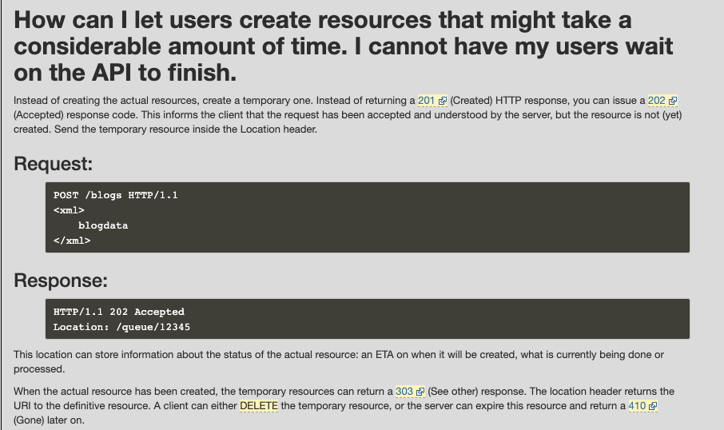
Asynchronous Requests – Pattern 1

Slide 28
Success Response Codes
202 means
Your request went asynch.
The HTTP header Link is where to poll for rsp.
Operation | HTTP Request | HTTP Response Codes Supported
READ | GET | 200 - OK with message body 204 - OK no message body 206 - OK with partial message body
CREATE | POST | 201 - Resource created (Operation Complete) 202 - Resource accepted (Operation Pending)
UPDATE | PUT | 202 - Accepted (Operation Pending) 204 - Success (Operation Complete)
DELETE | DELETE | 202 - Accepted (Operation Pending) 204 - Success (Operation Complete)
Examples of Link Headers in HTTP response:
Link: <http://api/jobs/j1>;rel=monitor;title="update profile"
Link: <http://api/reports/r1>;rel=summary;title=”access report”

Slide 29
Using a Cloud Service
29 | E6156 – Cloud Computing: Backend-as-a-Service

Slide 30
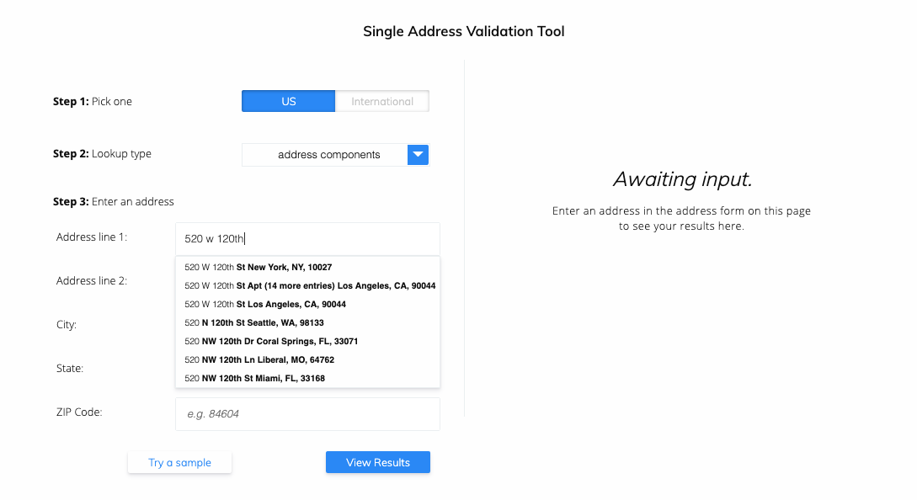
Address Verification (Demo)
People are really bad at entering addresses.
US, USA, United States, UK, England, ... ...
MA, Mass, Massachusetts, ... ...
NYC, New York, Manhattan, ... ...
W. 120th St, West 120 Street, ... ...
You should not have them enter an address, verify, reject, try again, reject, ... ... ➔ They will go to someone else.
You need to implement two functions:
In browser/UI completion suggestion.
In microservice verification before storing, in case no your UI.

Slide 31
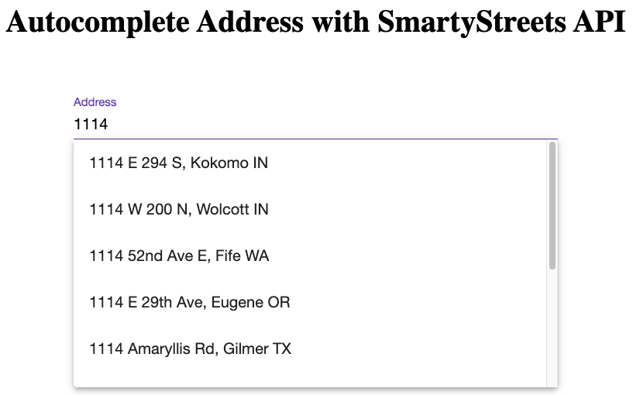
Address Verification (Demo)
https://github.com/shahinkar/Angular-SmartyStreets

Slide 32
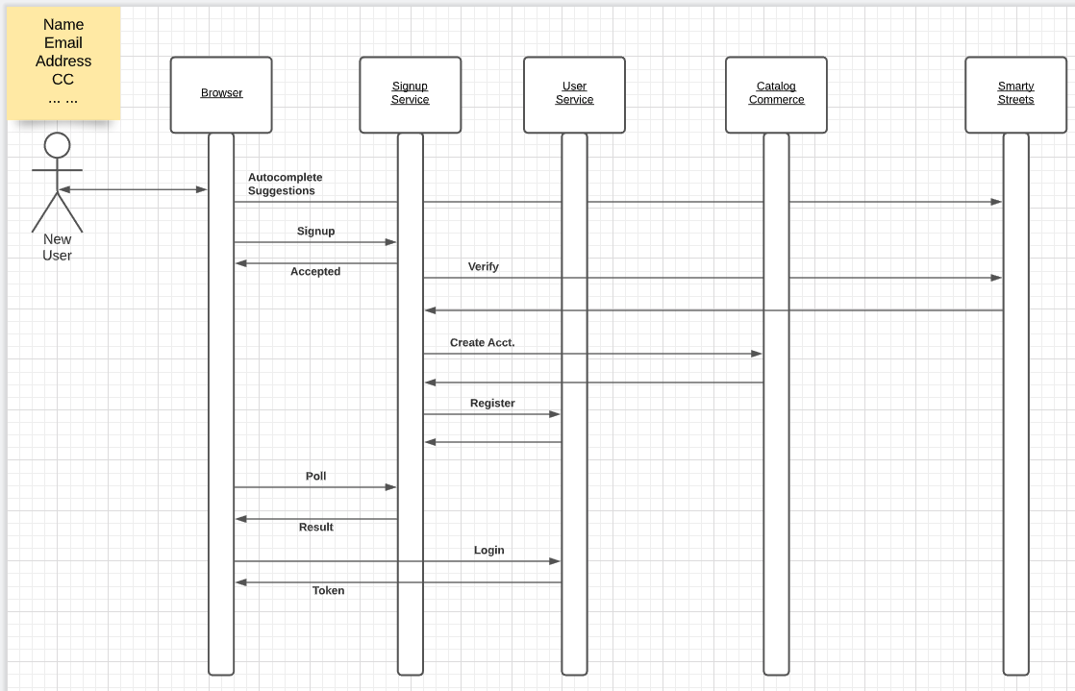
Address Verification Flow
You need to verify in the UI for usability.
You need to verify the address in case it the signup came from some other client/application.

Slide 33
Address Verification Flow
Demo Python Unit Test

Slide 34
Middleware
34 | E6156 – Cloud Computing: Backend-as-a-Service

Slide 35
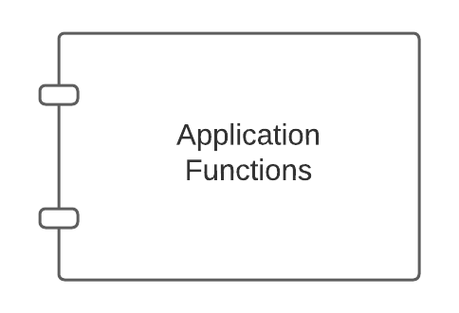
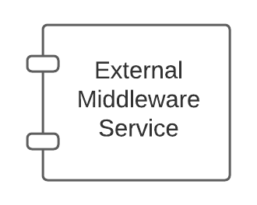
Middleware
There are app server specific approaches to injecting into the applications.

Slide 36
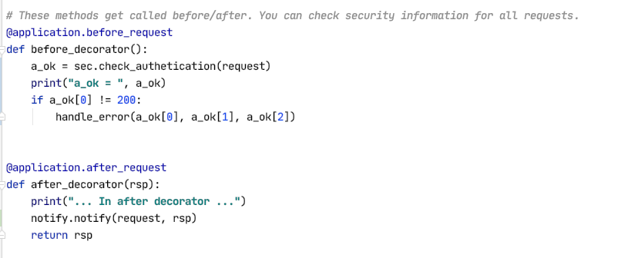
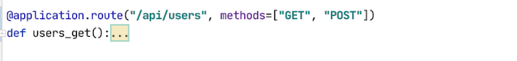
Middleware and Flask
White list of URLs
If not on white list:
Verify token
Verify authorization
List of filters of the form:
URL
HTTP Method
SNS topic to use
Send an event to SNS if matches filter
Show some demo code.

